Slide 1

10) Constrained Optimization Methods: Mathematical Programming

Slide 2
Mathematical programming is generally concerned with optimization (maximizing/minimizing) involving a set of variables subject to a set of constraints.
Math programming has been used to address a variety of applications:
product design and planning, media planning, transportation, scheduling, facility location.
Linear programming and nonlinear programming are types of mathematical programming techniques.
Linear programming: problems characterized by an objective function and set of constraints where all functions are linear.
Nonlinear programming: programming problems involving nonlinear relationships.

Slide 3

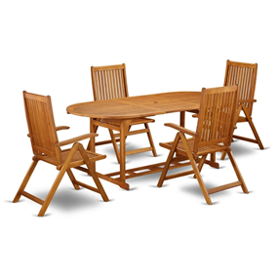
Example:
To illustrate the basic concepts we will start with a small production type problem. ABC furniture interested in planning for the number of chairs and tables to produce in a planning period for their line of patio furniture. It is desired to determine the number of chairs and tables to make to maximize profit.
Below is information about resources and unit profit for each product.

Slide 4
Problem Formulation
The first step is to translate the problem into the structure of a math programming problem (specification of the variables, objective function and constraints).
Obtaining the Solution
For Example 1 we will use two methods to obtain the solution: the graphical solution method and an algorithmic approach.
The graphical method is practical for small problems, and useful for illustrative purposes.
The algorithmic approach is more commonly found in practice.

Slide 5
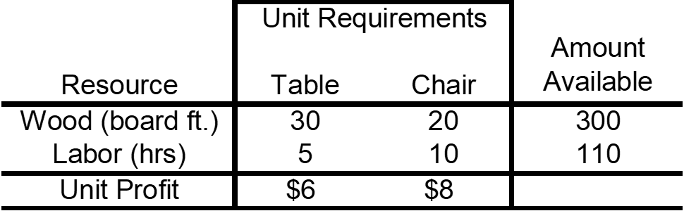
Formulation

Slide 6
Graphical Solution Method applied to example 1.
Basic steps:
-formulate the problem
-plot the constraints and determine the feasible region
-using the objective function determine the optimal solution (most attractive corner of the feasible region)
-determine the objective function value of the optimal solution

Slide 7
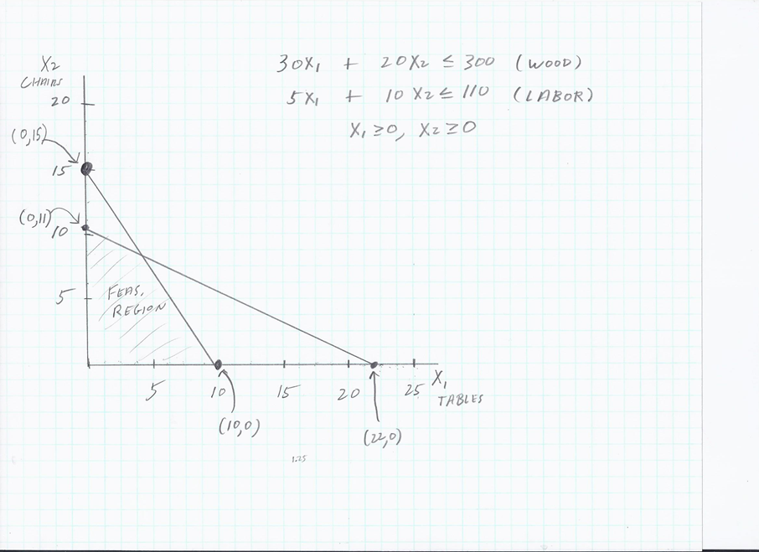

Slide 8
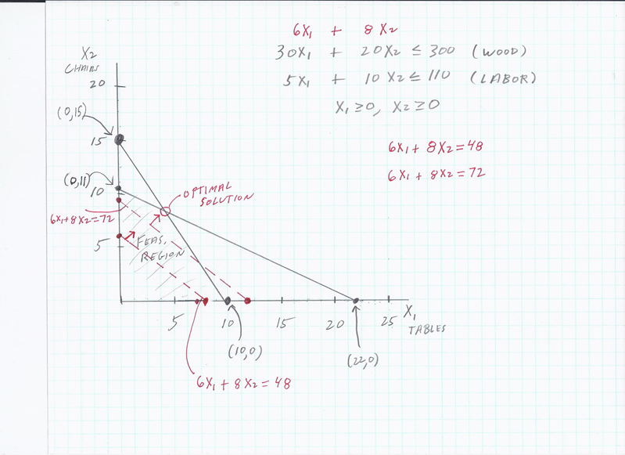

Slide 9
30 X1 + 20 X2 = 300
-2( 5 X1 + 10 X2 = 110)
20 X1 = 80
X1 = 4
30 (4) + 20 X2 = 300
120 + 20 X2 = 300
20 X2 = 180
X2 = 9
So, Optimal Solution = X1 = 4 (Tables), X2 = 9 (Chairs)
And Profit = $6 X1 + $8 X2 =
$6 (4) + $8 (9) = $96

Slide 10
Algorithmic approach applied to example 1.
In general, algorithms (an algorithm is a set of step by step procedures that leads to the “best” solution) are used to solve math programming problems.
For linear programming problems like our example, an algorithm called the simplex method is commonly used to find the optimal solution.
Simplex works by starting with a feasible corner point solution (usually starts at a place that is easy to find such as the origin in our example (produce nothing), and then moves to the next neighboring corner point that improves the solution at the greatest rate. It continues in this way until the optimal solution is found.
Excel has a built-in optimization tool called Solver that we can use to solve the type of math programming problem of our example 1, as well as other types of math programming problems.

Slide 11
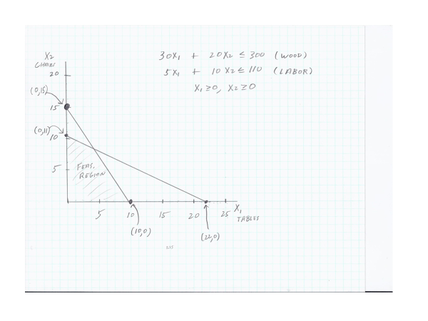
How the Algorithm Can Find the Optimal Solution
Max P = 6 X1 + 8 X2
s.t.
X1 X2 P
0 0 $0
0 11 $88
4 9 $96
(4,9)
(0,0)

Slide 12
To load Solver in Excel
Click File, Options, Add-Ins
Select Solver Add-In and click Go
Click Solver Add-In and Ok. Solver should now appear on the Data tab in the Analysis section.
Open file MP_example1_solver.xls

Slide 13
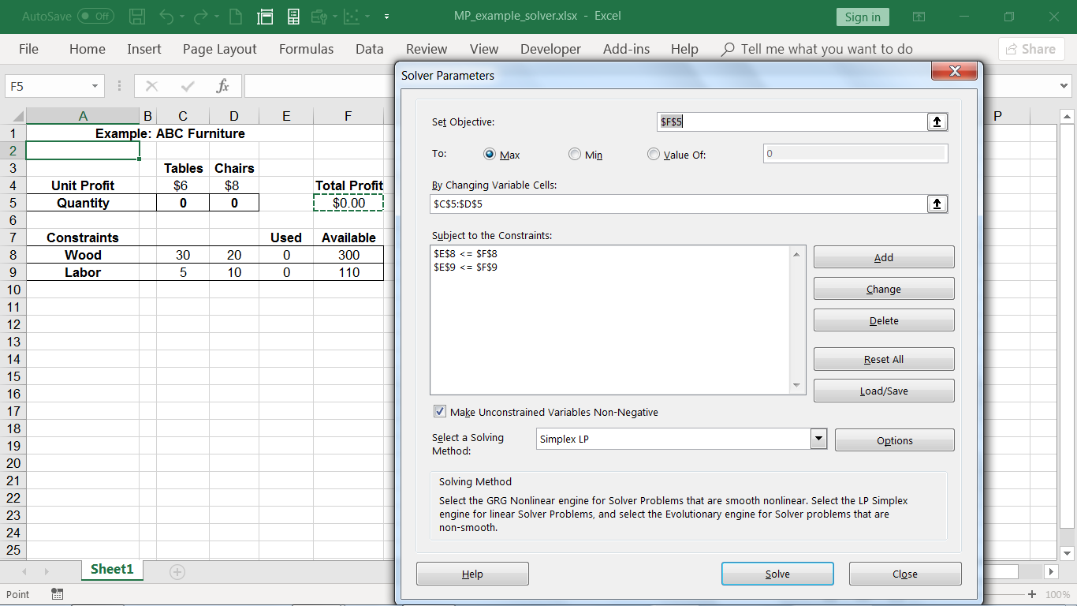
In the Data tab, click Solver

Slide 14
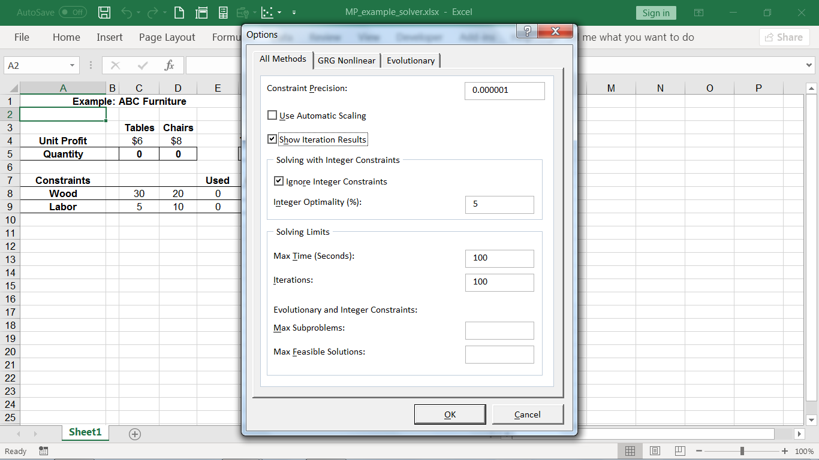
Click Options, Show Iteration Results. Ok, Solve

Slide 15
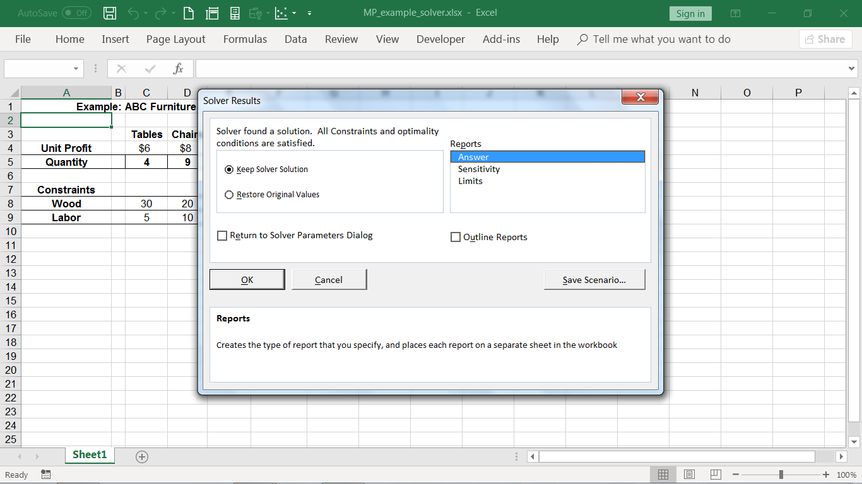
Continue through the steps until a solution is found
Select the Answer Report and click Ok

Slide 16
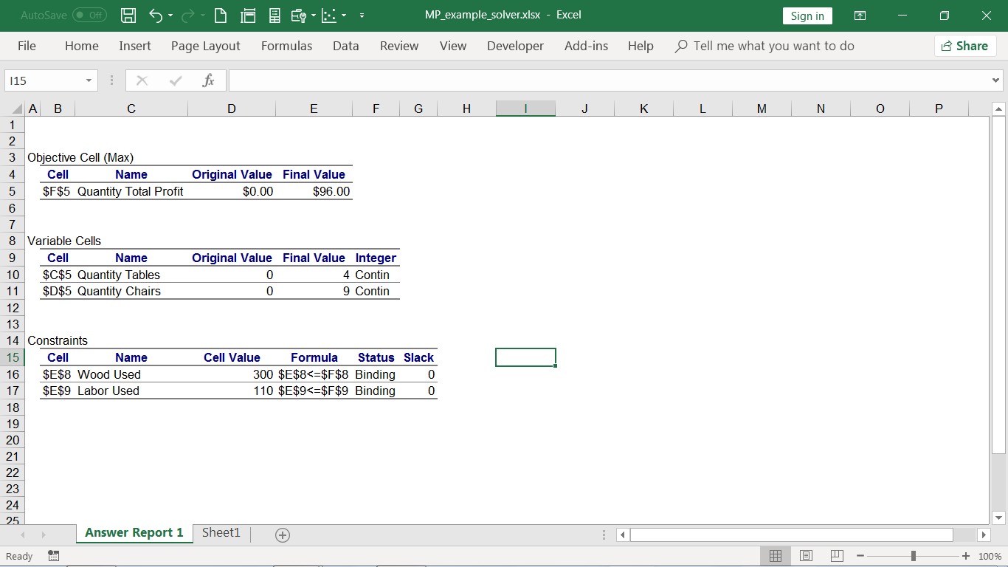
Interpret the solution

Slide 17
Added Application 1)
A field company has obtained a project that involves interviewing physicians in two different regions of the country (North East and South), and two different physician types (cardiologists and internists). 1000 interviews are to be conducted, and the following guidelines have been specified:
-At least 400 physicians in the North East would be interviewed.
-At least 400 physicians in the South would be interviewed
-The total number of cardiologists interviewed would be at least as great as the number of internists interviewed.
-At least 35% of the interviews for the NE region would be conducted with cardiologists
-At least 60% of the interviews for the southern region would be conducted with cardiologists.
Interview costs differ based on region and physician type according to the following.
What is the optimal field plan that will satisfy the guidelines?

Slide 18
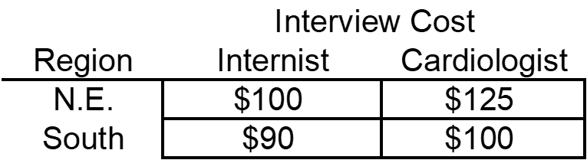
Let X11 = # of Internists in NE
X12 = # of Cardiologists in NE
X21= # of Internists in South
X22= # Cardiologists in South

Slide 19
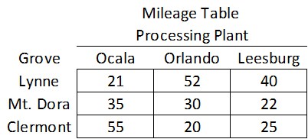
Added Application 2) Network flow problem
Sweet Water Citrus (SWC) has grapefruit groves in three different central Florida cities: Lynne, Mt. Dora, and Clermont. The groves currently have the following bushels of grapefruit at the respective cities 265,000 at Lynne, 400,000 at Mt. Dora, and 300,000 at Clermont.
They also have three processing plants in Ocala, Orlando, and Leesburg with the following capacities, respectively: 200,000 580,000 and 225,000. A flat rate is charged by a trucking company for each bushel-mile, and the mileage is summarized in the table below.
SWC wants to determine an optimal shipping plan. Provide a formulation and solution for SWC.

Slide 20
